Slide 1
Leisure Goals
DATA 211 Project
Zachary “DoctorFarmer” Farmer

Slide 2
Data Set
Description: Time spent (in minutes) playing video games and reading fiction, non-fiction, and comics
Collection Process: Manual, timed with a stopwatch
Period: 4/01/22 - 4/15/22

Slide 3
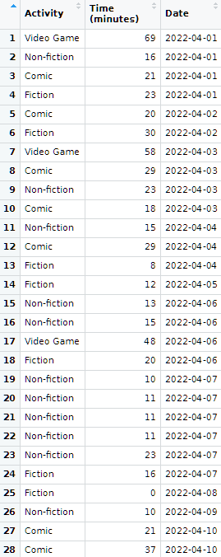
Data Set
Data Set Name:
reading_gaming
Variables:
Activity
Categorical
Time (minutes)
Numeric
Date
Categorical

Slide 4

Question to be Tested
Is the average amount of time I spend reading per day greater than 30 minutes?
H0: μ_reading = 30
Ha: μ_reading > 30

Slide 5
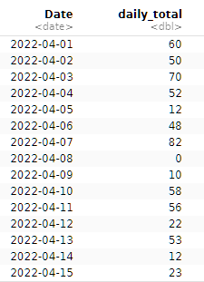

Data Wrangling
?
Is there missing data?
On 4/08/22, I didn’t spend any time reading. To make sure this date was accounted for, I added an additional data point of 0 minutes reading fiction on April 8.
How do I total reading time?
Since total reading data was collected in three different categories (fiction, non-fiction, and comics), and I didn’t need my Video Game data at all, I used the filter, group_by and summarize functions to find daily reading totals, stored as daily_reading.

Slide 6
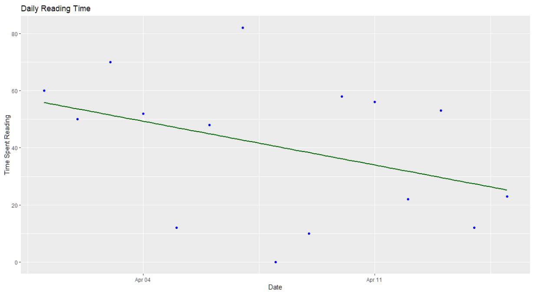
Scatter Plot w/ Regression
Regression line is a weak fit to the data

Slide 7
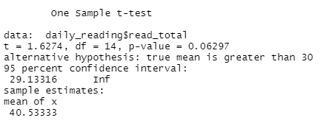
T-Test
t.test(daily_reading$read_total, mu=30, alternative="greater")

Slide 8
Result
Fail to reject H0!
There is not sufficient evidence to support the claim that my average daily time spent reading for pleasure is greater than 30 minutes.

Slide 9
What is my leisure goal? Find more time to read!

Slide 10
DoctorFarmer on GitHub
You can find this project in my DataScienceDegree repository on GitHub!
https://github.com/DoctorFarmer/DataScienceDegree
Link to presentation

